Slide 1


Imputation Performance
GA-Workshop 28-Sep-2020
Yu Wang (yu.wang@lic.co.nz )

Slide 2

Topics today
How to evaluate the imputation accuracy?
What are the parameters influence accuracy?
Imputation to the sequence level

Slide 3
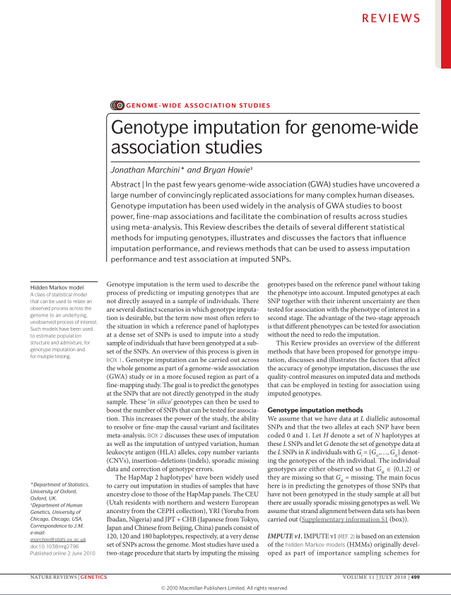
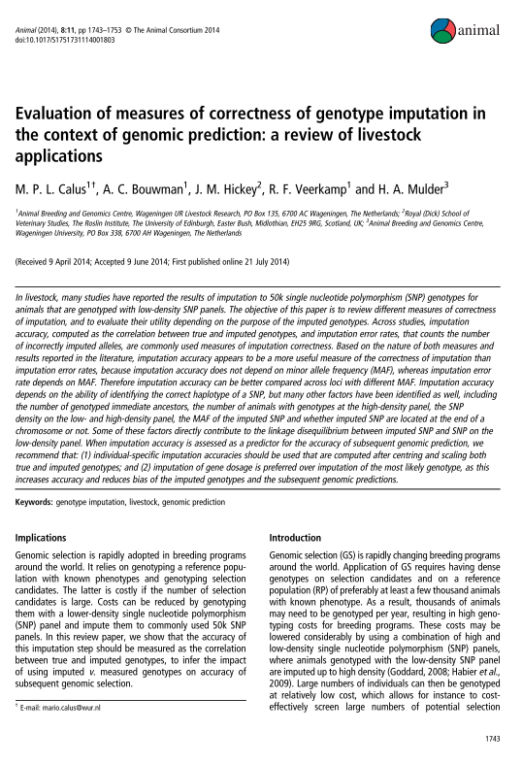
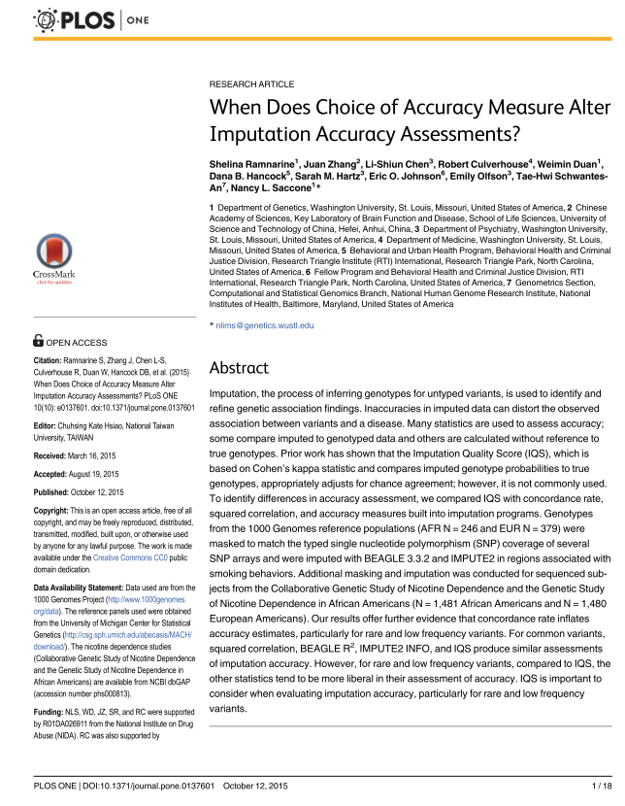
Marchini, Jonathan, and Bryan Howie. "Genotype imputation for genome-wide association studies." Nature Reviews Genetics 11.7 (2010): 499-511.
Calus, M. P. L., et al. "Evaluation of measures of correctness of genotype imputation in the context of genomic prediction: a review of livestock applications." Animal 8.11 (2014): 1743-1753.
Ramnarine, Shelina, et al. "When does choice of accuracy measure alter imputation accuracy assessments?." PloS one 10.10 (2015): e0137601.

Slide 4
Why we need accurate imputation
Fill in missing genotypes from the lab
Merge data sets with genotypes on different arrays
Eg. Affy and Illumina data
Impute from low density to high density
7K-> 50K (save $$$)
50K->800K
capture power of higher density?
Sequence expensive, can we impute to full sequence data?

Slide 5
What are the parameters to evaluate imputation accuracy
Genotype concordance (1-error rate)
Genotype concordance is computed per locus as the percentage (or proportion) of alleles or genotypes that is imputed incorrectly. A closely related measure is the percentage of correctly imputed alleles or genotypes, which can simply be calculated as 100% minus the imputation error rate. Need to know the true status.
Genotype correlation
Pearson correlation coefficient between true and imputed genotypes. Need to know the true status.
Dosage/Allelic R-square
BEAGLE R2 approximates the squared correlation between the most likely genotype and the true unobserved allele dosage. IMPUTE2/Minimac3 INFO considers allele frequency as well as the observed and expected allele dosage. Neither of these makes use of true genotypes.
Imputation Quality Score (IQS) (Lin et al (2010))
It adjusts the concordance between imputed and genotyped SNPs for chance, however is not widely used in accuracy assessment.

Slide 6
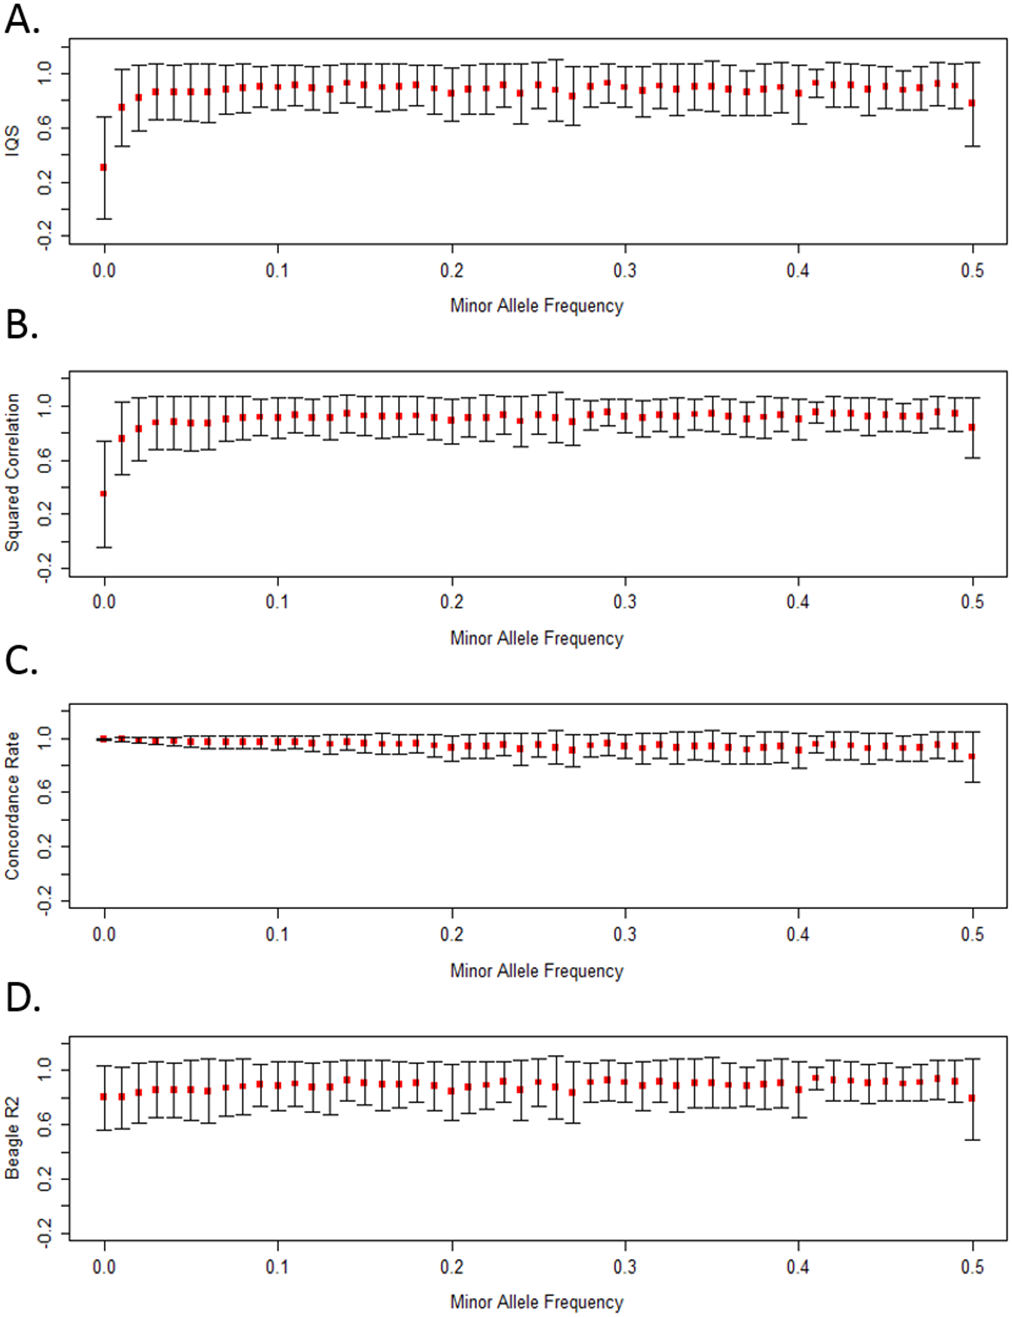
Why we don’t recommend using error rate
Our results provide further evidence that concordance rate inflates accuracy estimates particularly for rare and low frequency variants. These observations highlight a need to account for chance agreement not only when assessing imputation accuracy, but also more broadly in other situations for which concordance is traditionally used to assess accuracy, such as checking genotype agreement across duplicate samples. Concordance rate will always produce a value greater than or equal to IQS due to their mathematical relationship (see Methods for proof).
Ramnarine, Shelina, et al. "When does choice of accuracy measure alter imputation accuracy assessments?." PloS one 10.10 (2015): e0137601.

Slide 7
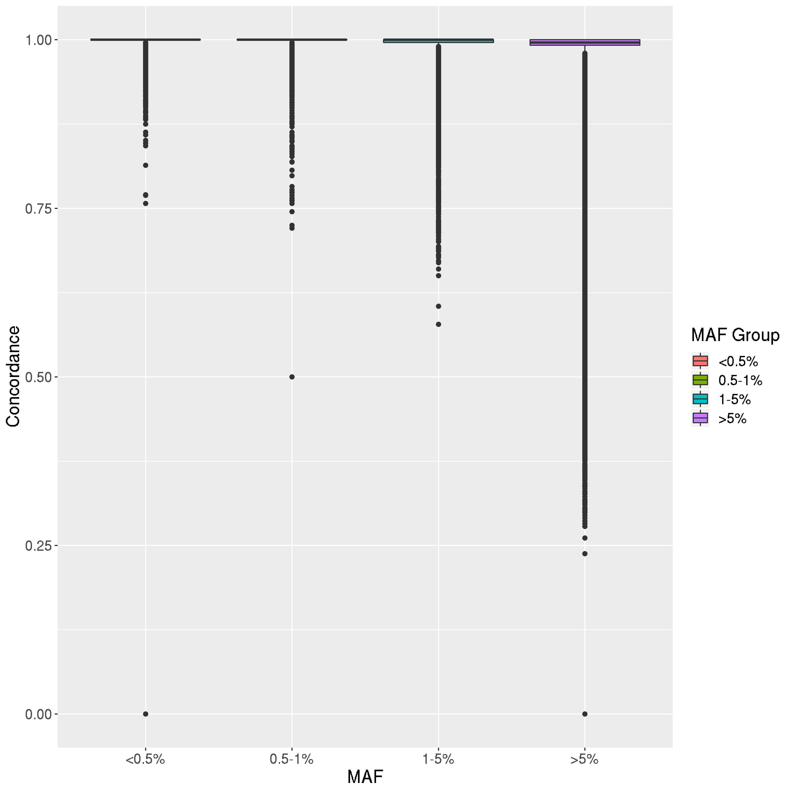
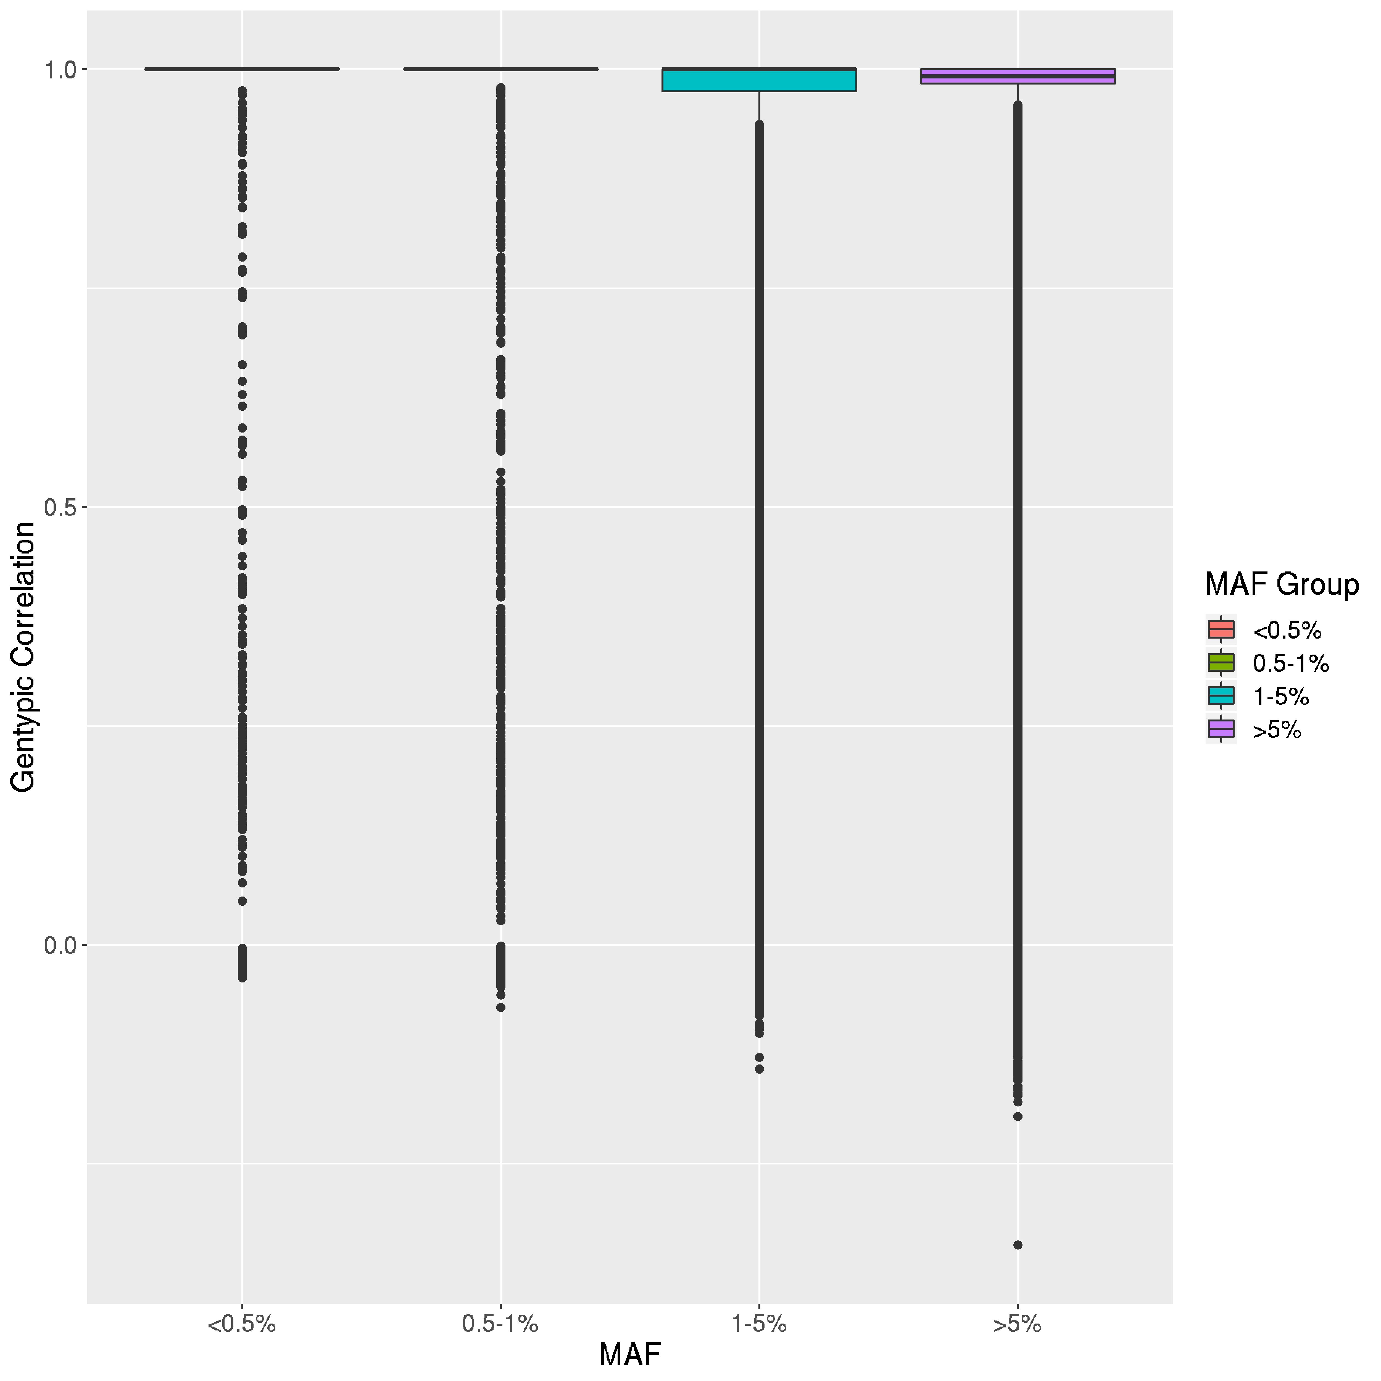
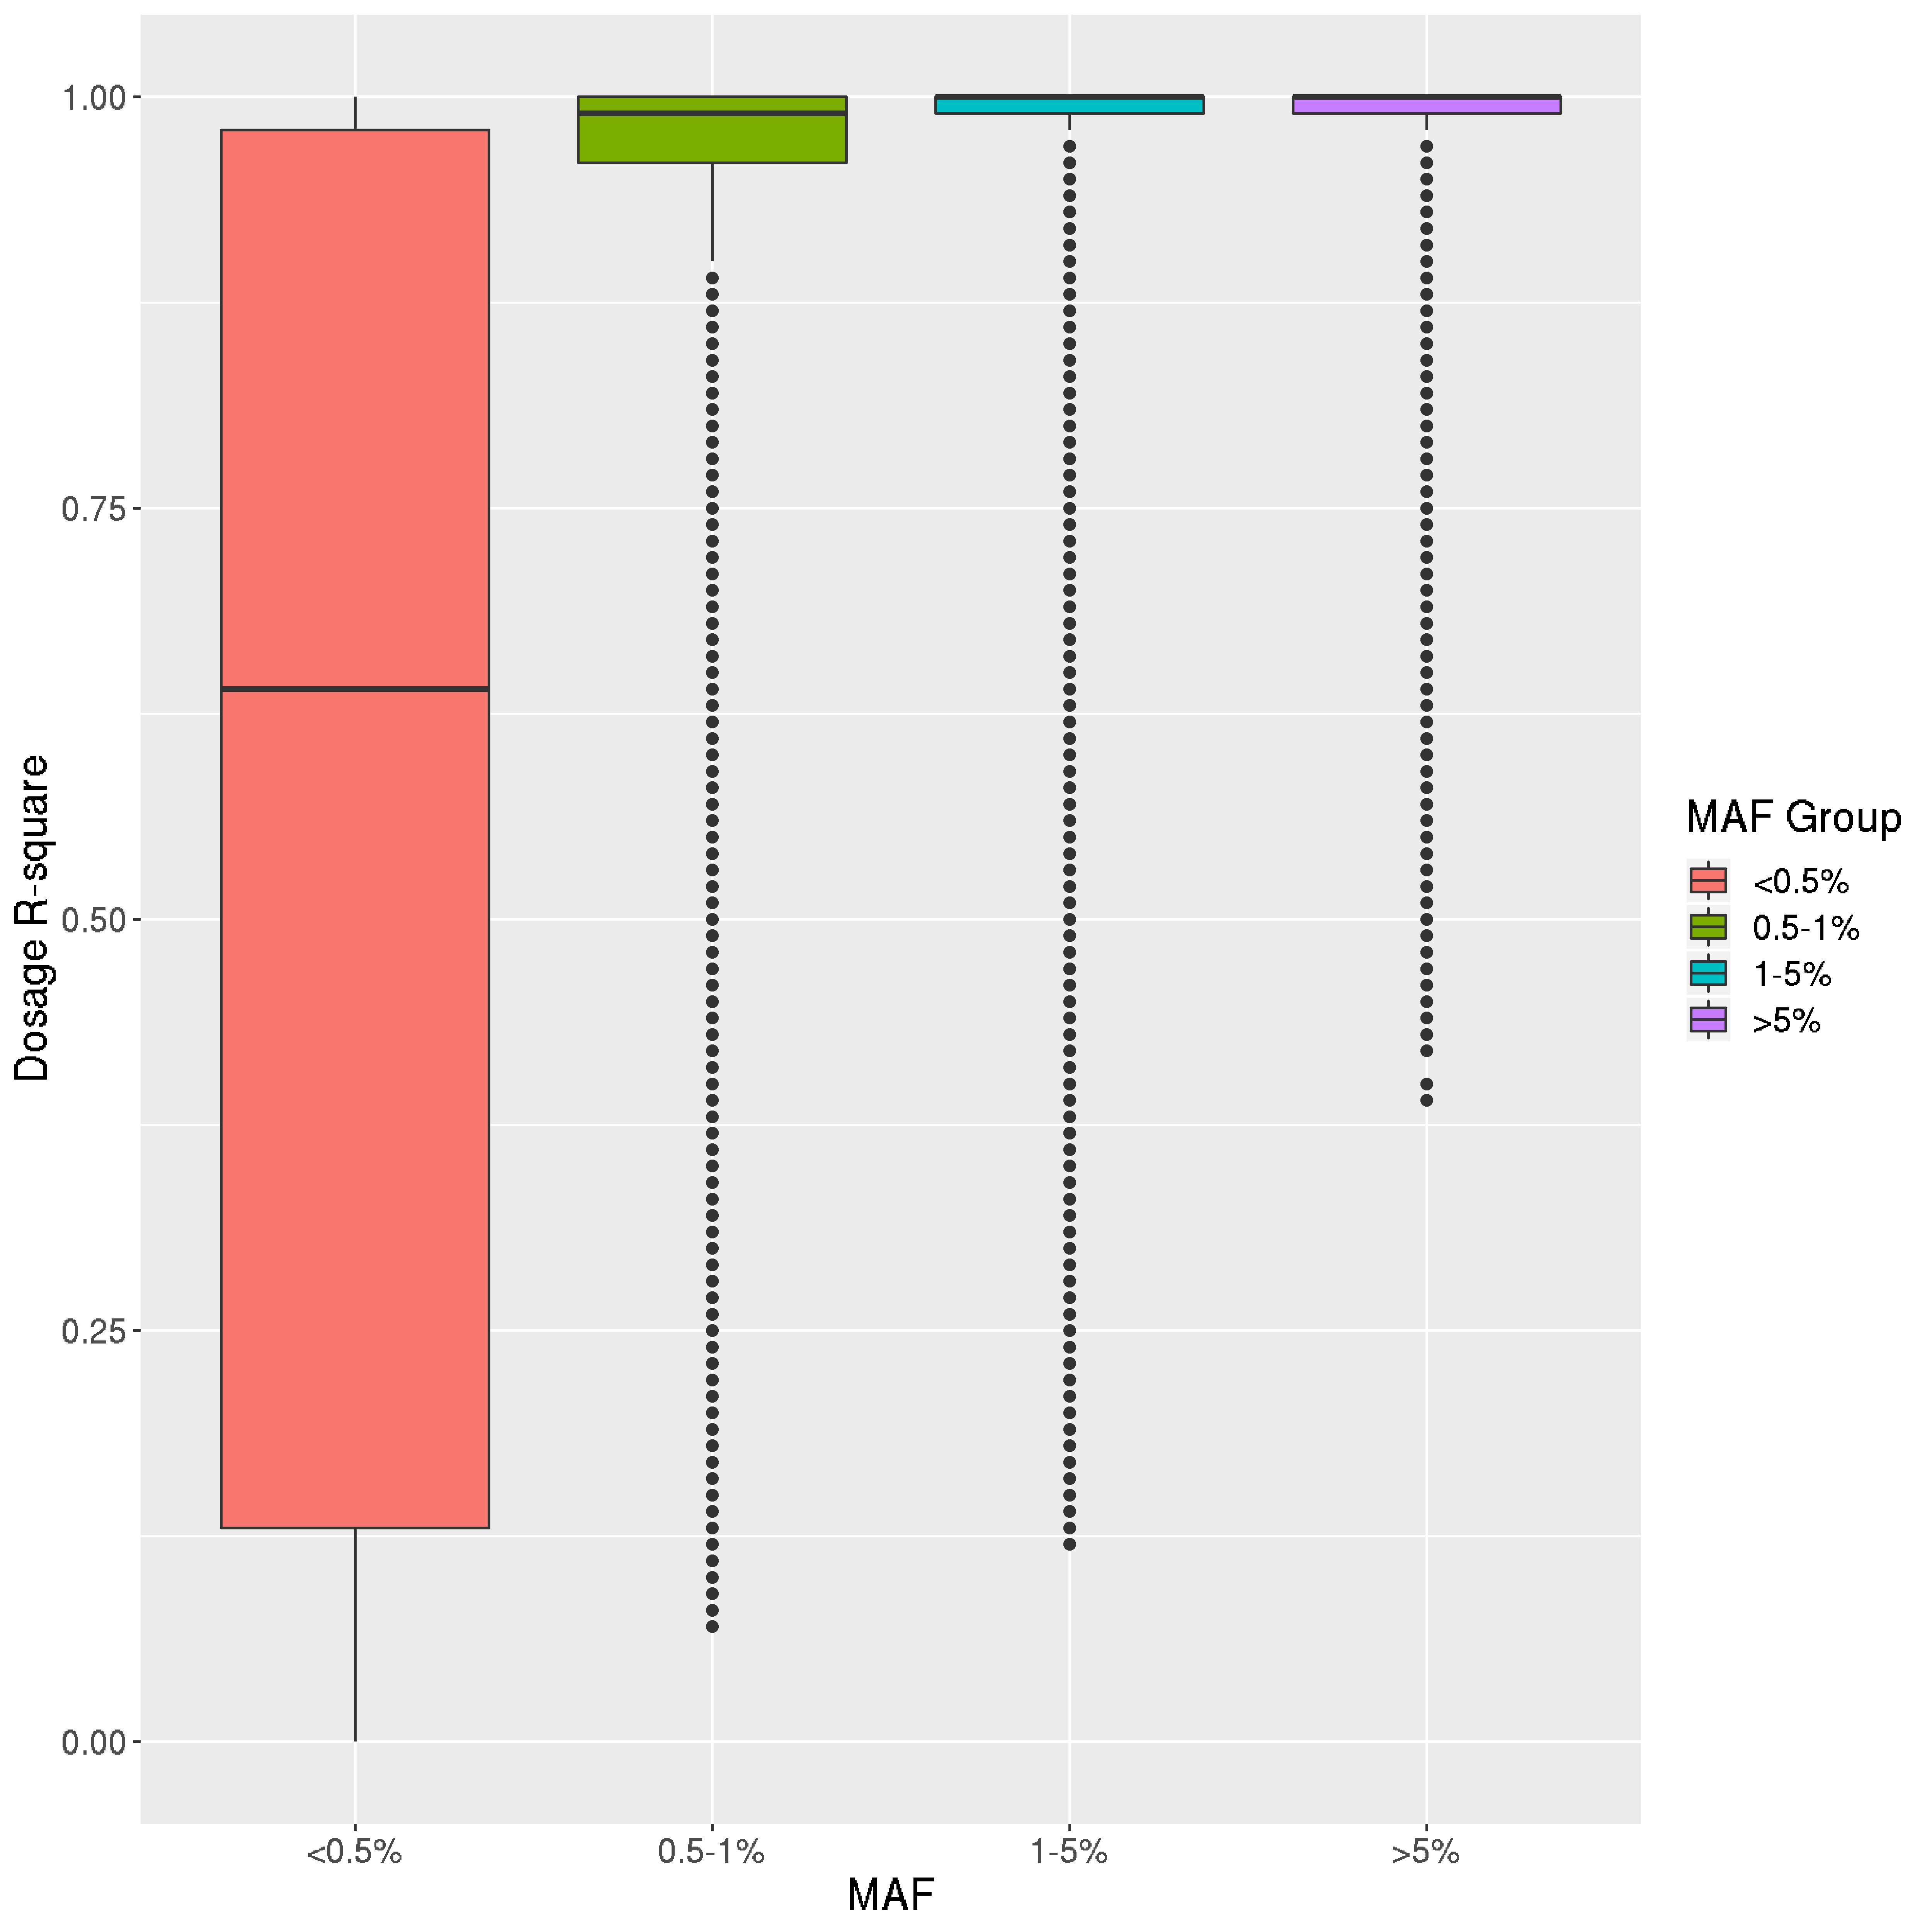
Why we don’t recommend using error rate

Slide 8
Factors affect imputation accuracy
Number of ancestors genotyped in the reference (Hickey et al., 2011; Huang et al., 2012a)
SNP density on the low and high panel (Mulder et al., 2012)
MAF of the imputed SNP (van Binsbergen etal., 2014)
Whether imputed SNP are located at the end of a chromosome or not (Badke et al., 2013; Cleveland and Hickey, 2013; Wellmann et al., 2013)
The number of individuals with genotypes at the imputed density (Zhang and Druet, 2010)
The relationship between imputed individuals and individuals genotyped at high density (Hickey et al., 2012)

Slide 9
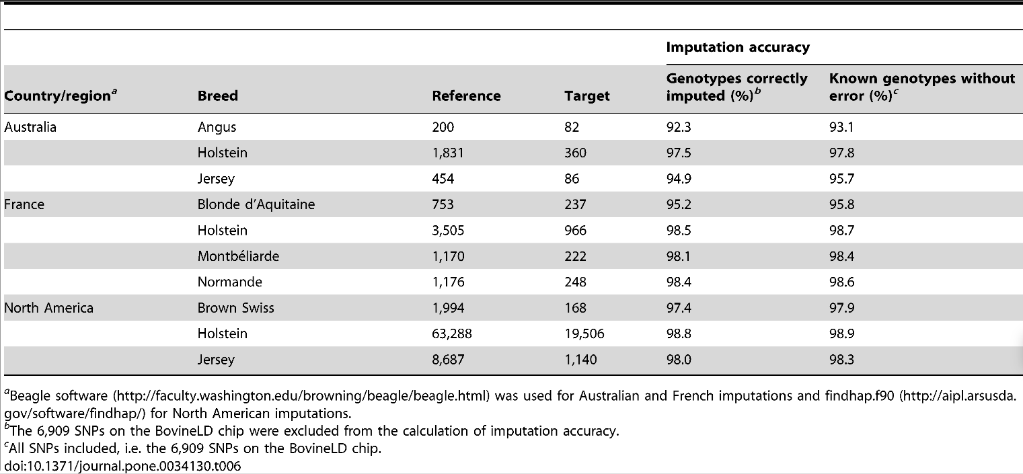

Table 6. Accuracy of imputation from BovineLD genotypes to BovineSNP50 genotypes for Australian, French, and North American breeds.
Boichard D, Chung H, Dassonneville R, David X, et al. (2012) Design of a Bovine Low-Density SNP Array Optimized for Imputation. PLoS ONE 7(3): e34130. doi:10.1371/journal.pone.0034130
http://www.plosone.org/article/info:doi/10.1371/journal.pone.0034130

Slide 10
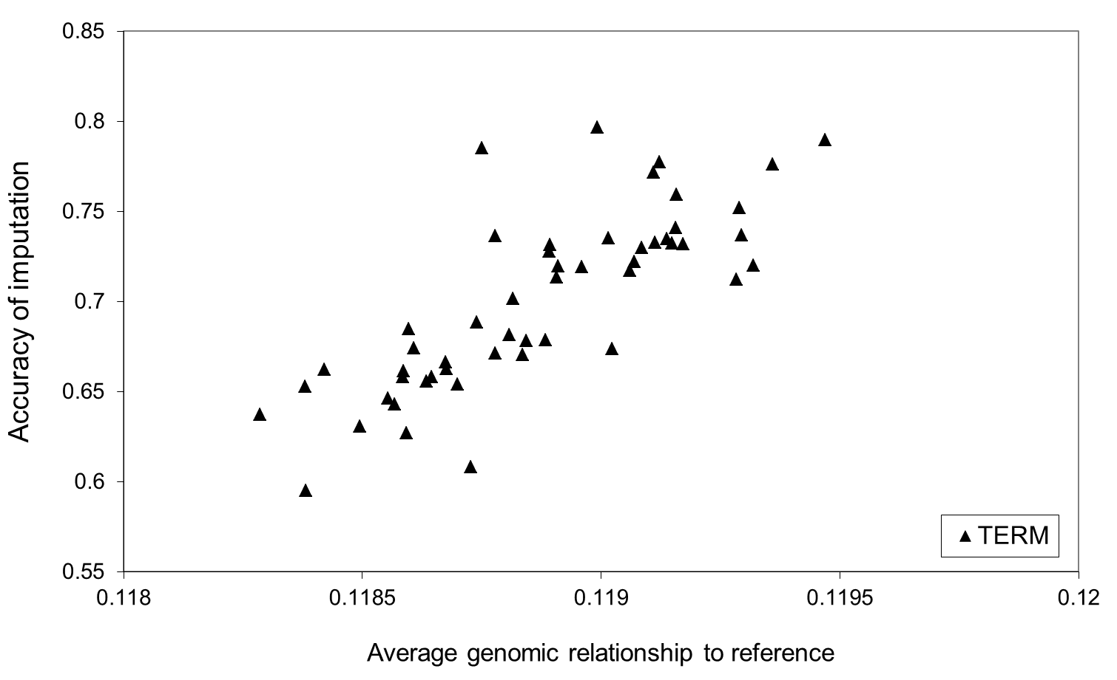
Imputation accuracy
Relationship to reference?

Slide 11
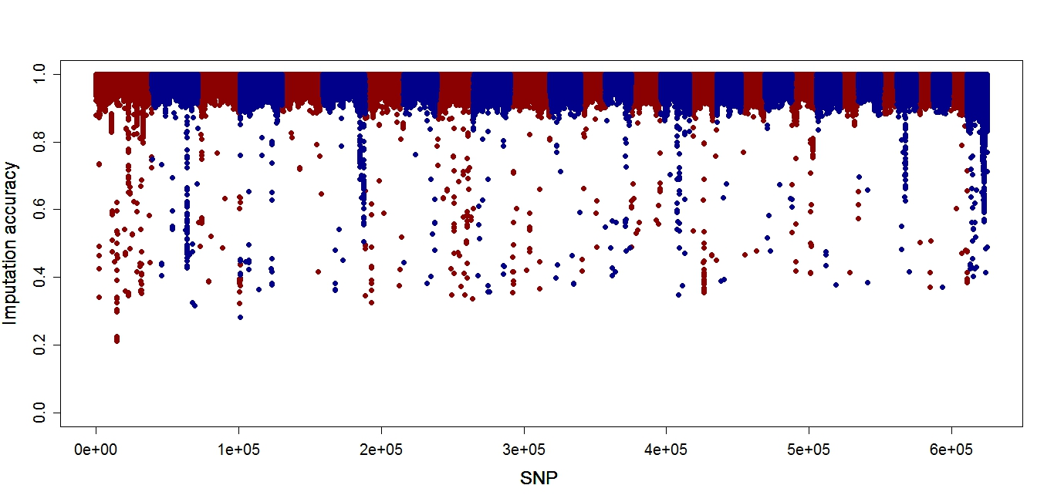
Imputation accuracy
Effect of map errors?

Slide 12
Imputation of full sequence data
Two groups of individuals
Sequenced individuals: reference population
Individuals genotyped on SNP array: target individuals
Steps:
Step 1. Find polymorphisms in sequence data
Step 2. Phase genotypes (eg Beagle) in sequenced individuals, create reference file
Step 3. Genotype all study animals for polymorphisms (SNP, Indels)
Step 4. Impute all polymorphisms into individuals genotyped with SNP array

Slide 13
Imputation of full sequence data
Beagle Phasing in Reference
Input genotype probs from Phred scores
Quality control
Create BAM files
1. Filter reads on quality score, trim ends
2. Remove PCR duplicates
3. Align with BWA
Variant calling
SamTools mPileup
Vcf file -> filter (number forward /reverse reads of each allele, read depth, quality)
BAM
Reference file for imputation
Analysis
Genome wide association
Genomic selection
Beagle Imputation in Target
SNP array data in target population
Genotype probabilities

Slide 14
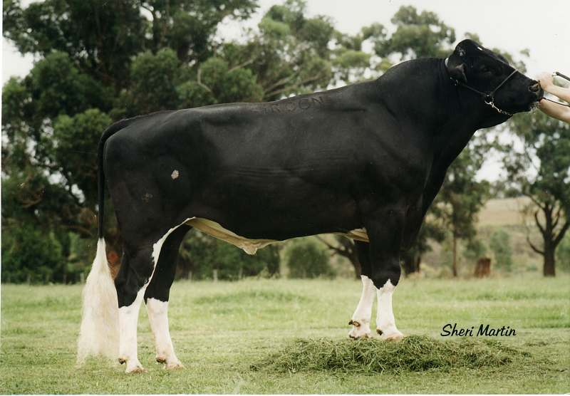
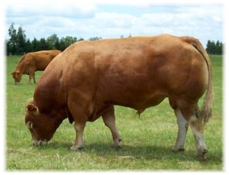
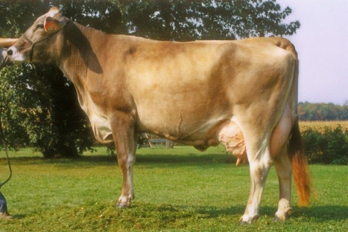
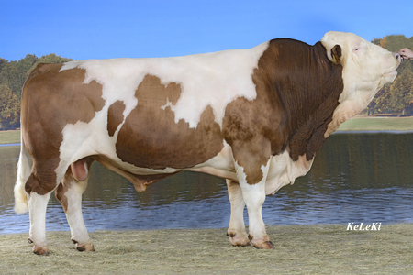
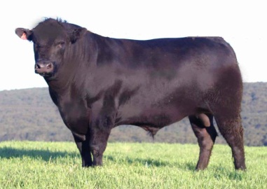
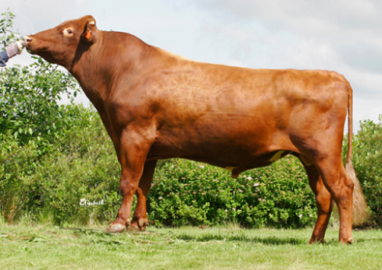
Run4.0 1000 bull genomes Run 4.0
Breed/Cross | Number
Holstein (Black and White) | 288
Simmental (Dual and Beef) | 216
Angus (Black and Red) | 138
Jersey | 61
Brown Swiss | 59
Gelbvieh | 34
Charolais | 33
Hereford | 31
Limousin | 31
Guelph Composite | 30
Beef Booster | 29
Alberta Composite | 28
Montbeliarde | 28
AyrshireFinnish | 25
Normande | 24
Holstein (Red and White) | 23
Swedish Red | 16
Danish Red | 15
Other Crosses | 11
Belgian Blue | 10
Piedmontese | 5
Eringer | 2
Galloway | 2
Unknown | 2
Scottish Highland | 2
Pezzata Rossa Italiana | 1
Romagnola | 1
Salers | 1
Tyrolean Grey | 1
Total | 1147
1147 animals sequenced
27 breeds
20 Partners
Average 11X
CRV

Slide 15
1000 bull genomes Run 4.0
36.9 million filtered variants
35.2 million SNP
1.7 million INDEL
X

Slide 16
Imputation of full sequence data
Accuracy?
Chromosome 14
Remove 50 Holsteins, 20 Jerseys from data set
Reduce genotypes to 800K for these animals
Impute full sequence using rest of animals as reference
Notes:
16

Slide 17
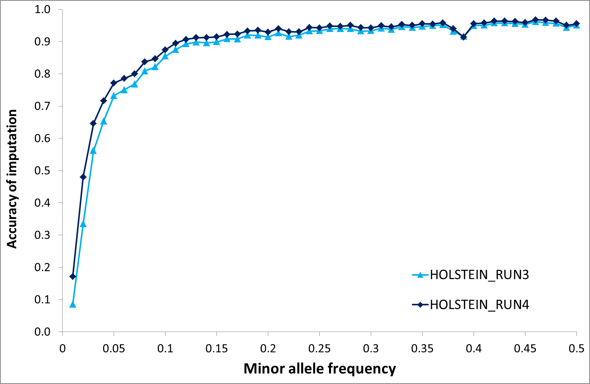
Imputation of full sequence data
Notes:
17

Slide 18
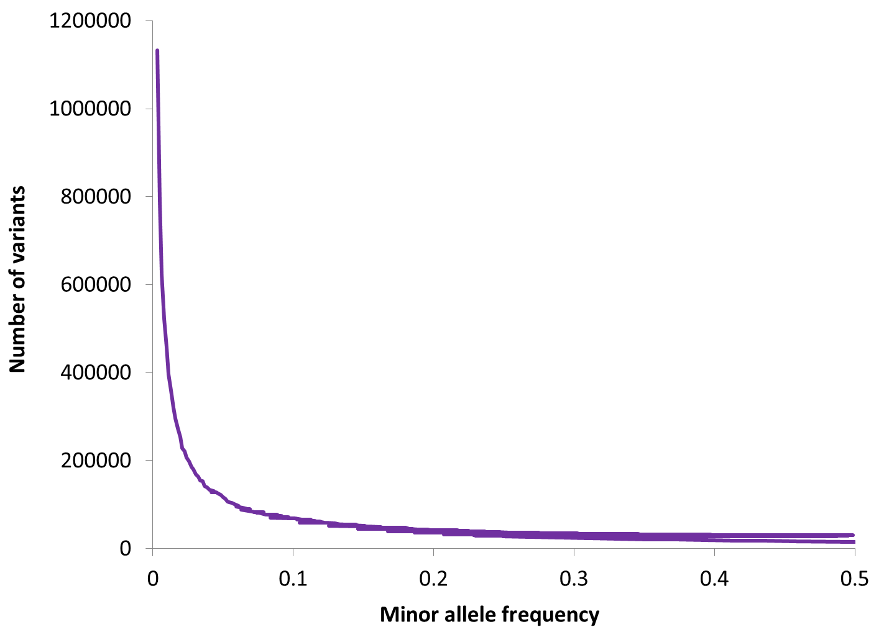
Imputation of full sequence data
Notes:
18

Slide 19
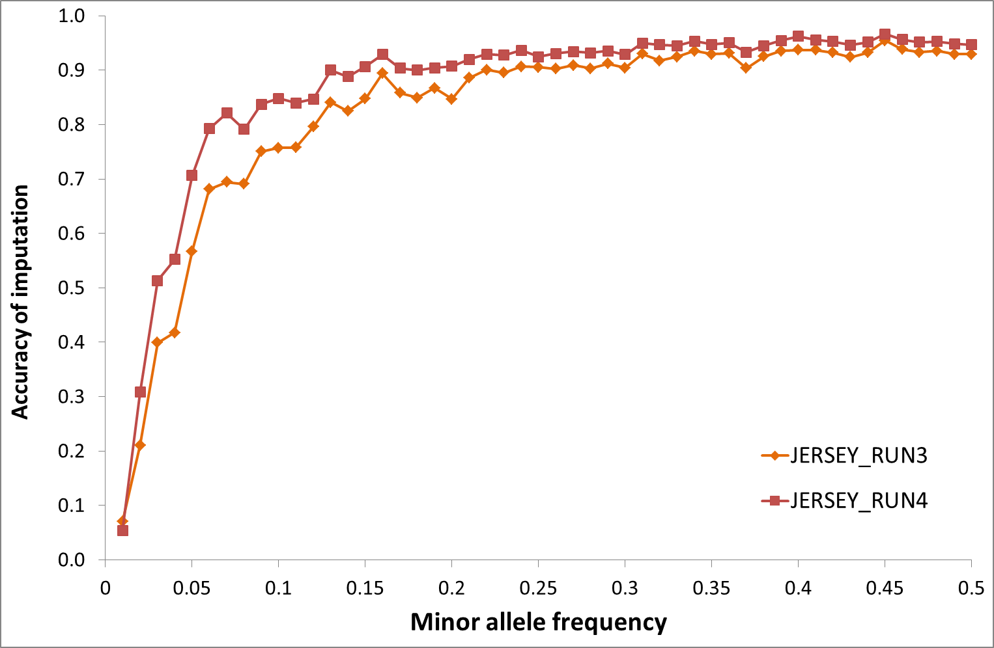
Imputation of full sequence data
Notes:
19

Slide 20
Imputation of full sequence data
Beagle – run imputation in chromosome segments, free, stable, new version (version 5.0 & 5.1) fast and accurate
Computational inefficient (large amount of memory required)
Minimac3 – free, stable, computational efficient, slightly slower than Beagle
FImpute – much faster than Beagle, computational efficient, be able to use pedigree information
Does not give probabilities, sometimes can have fatal error in the poorly assembled areas, input format is not friendly
Notes:
20

Slide 21
Post imputation QC
After imputation you need to check that it worked and the data look ok
Things to check
Plot r2 across each chromosome look to see where it drops off
Plot MAF-reference MAF
For each chromosome check N and % of SNPs:
MAF <.5%
With r2 0-0.3, 0.3-0.6,0.6-1
If you have hard calls or probs data HWE P < 10E-6
If you have families convert to hard calls and check for Mendelian errors (should be ~.2%)

Slide 22
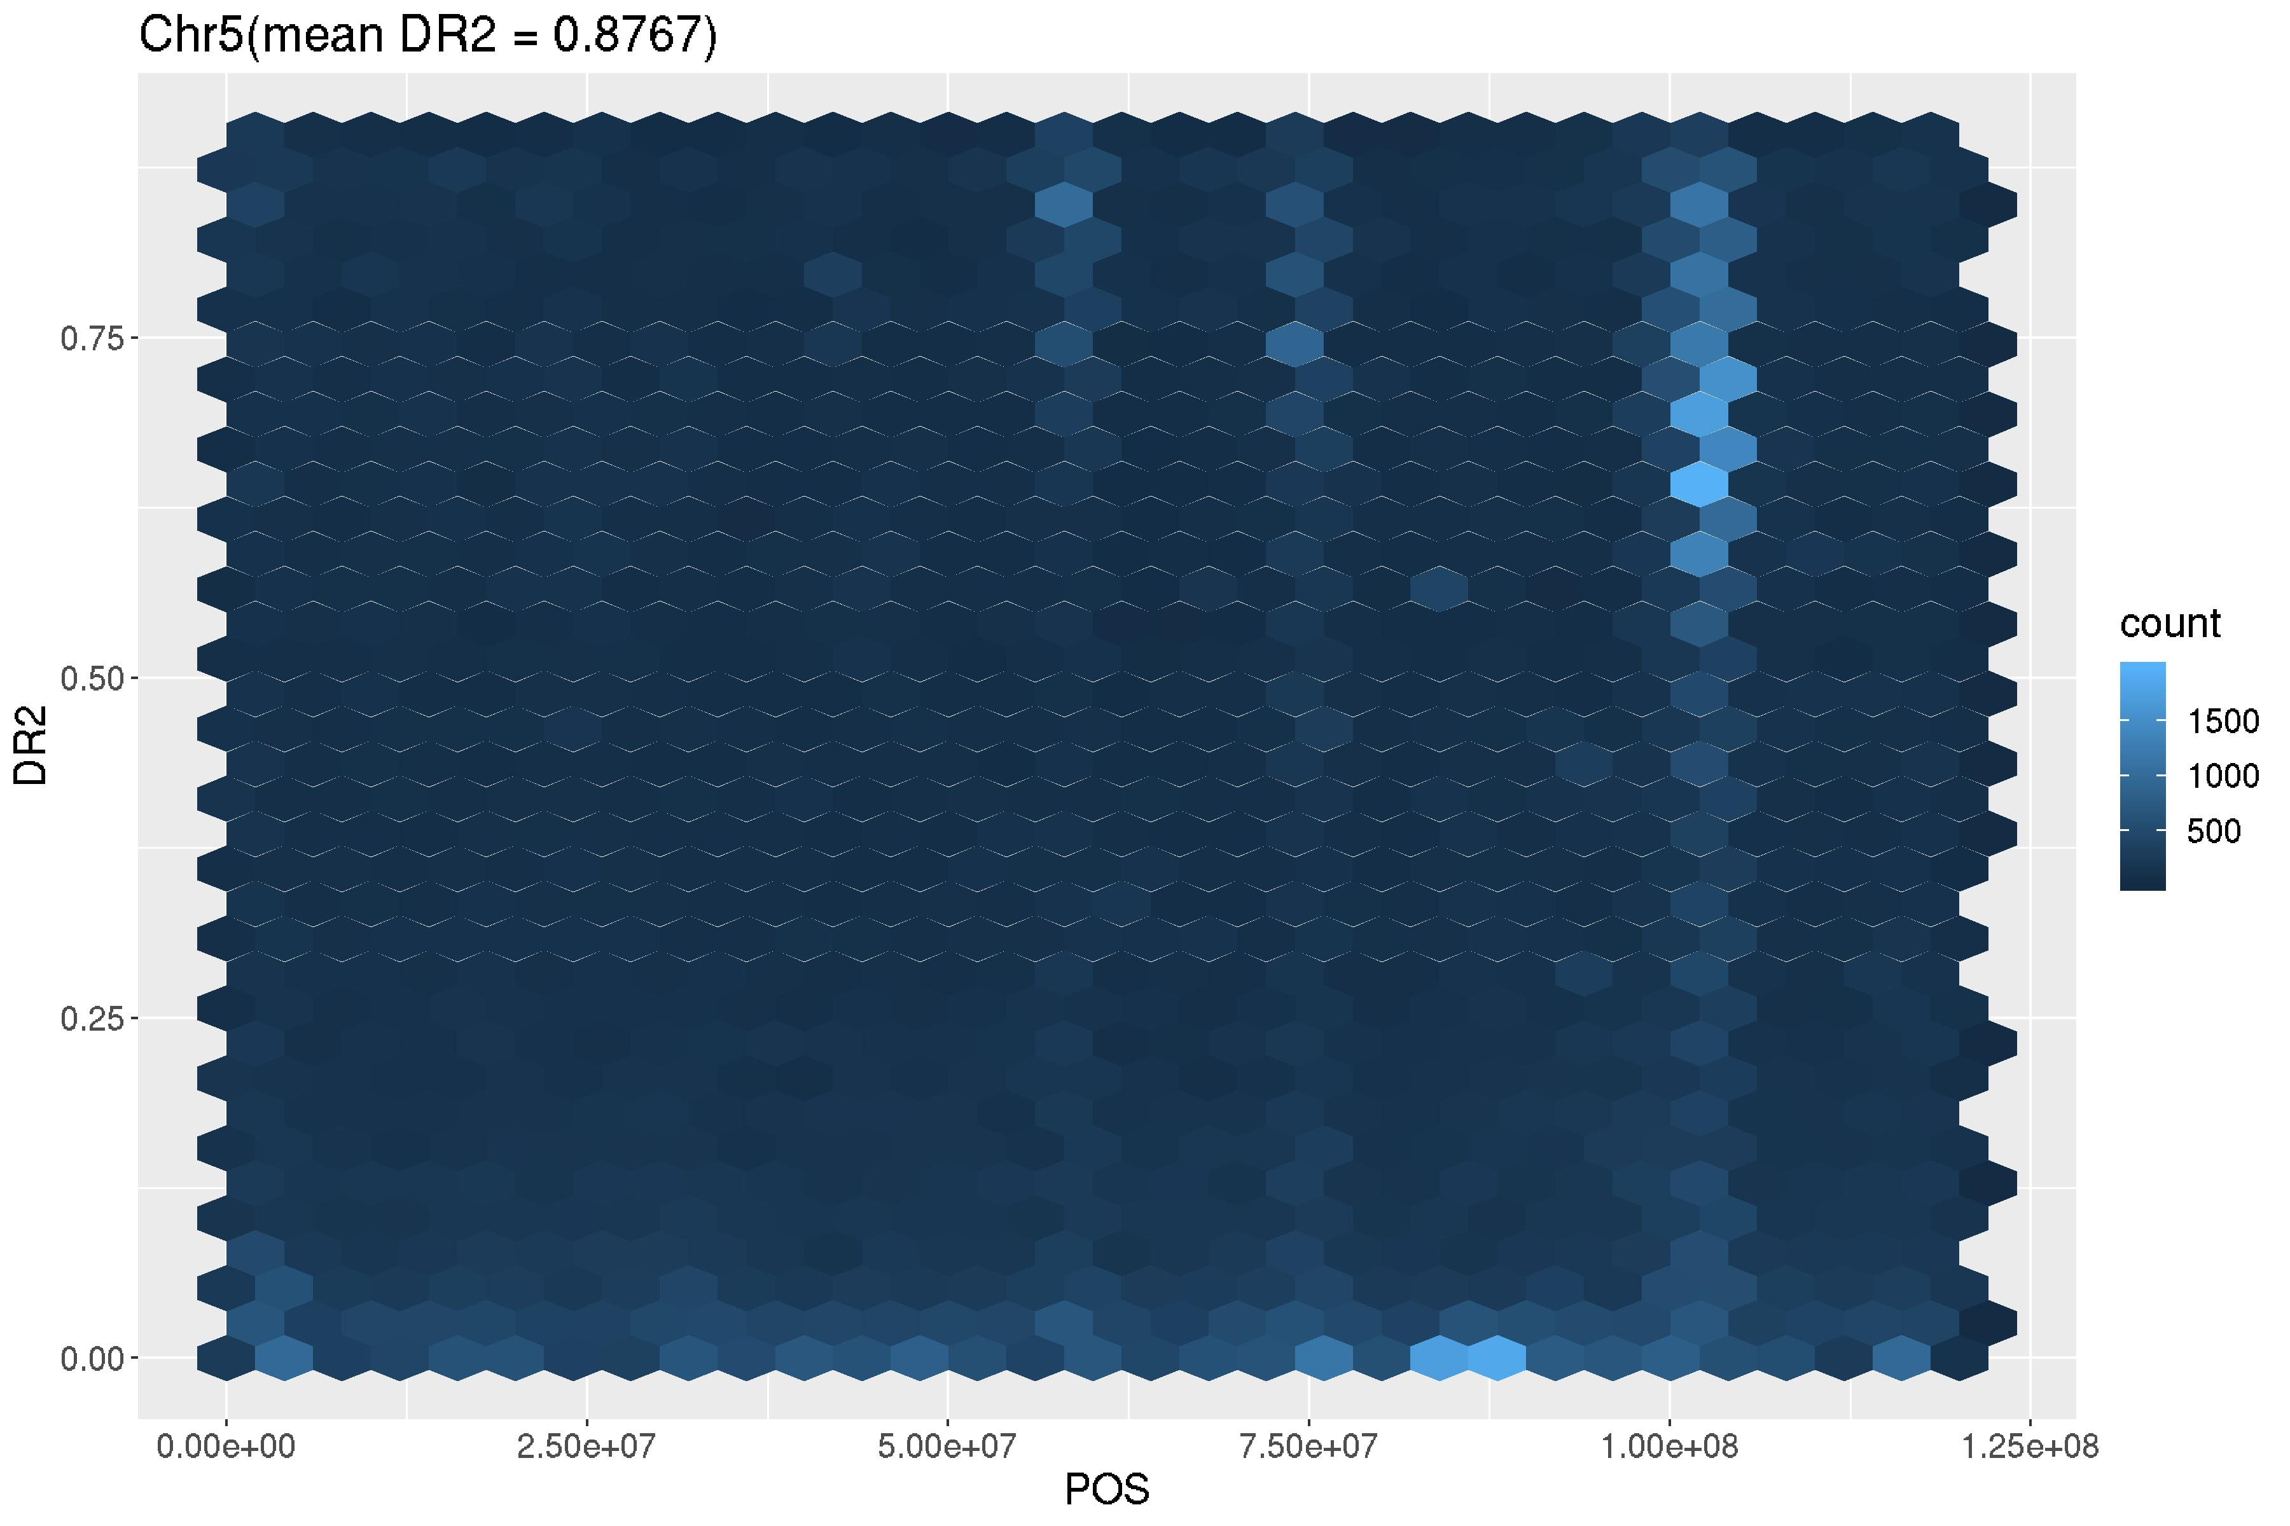
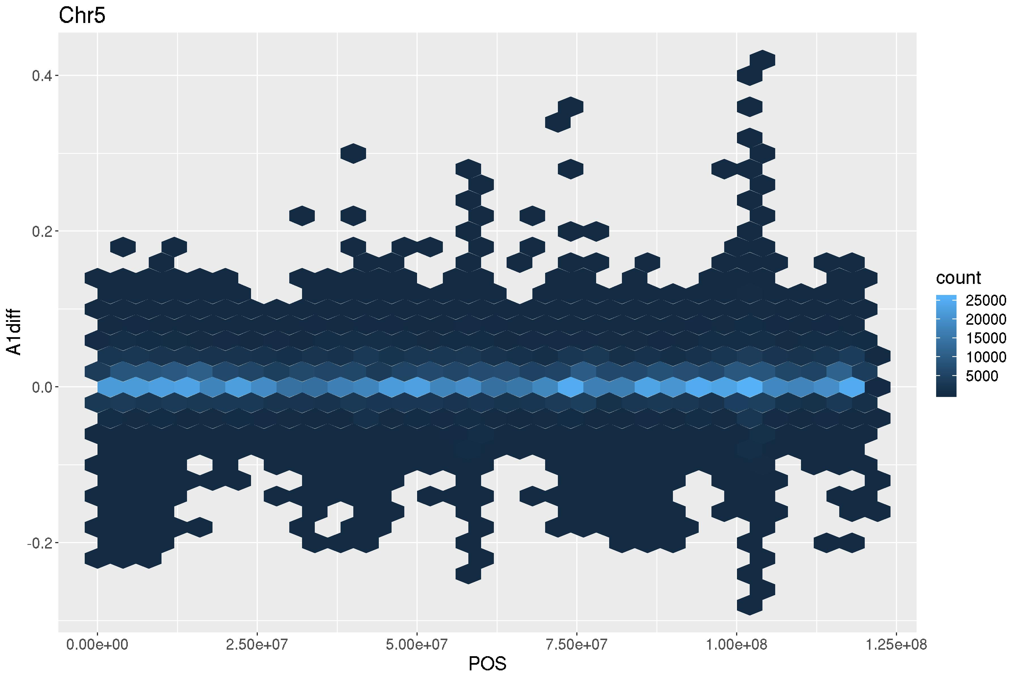
Post imputation QC

Slide 23
Take Home Message
Impute
to fill in missing genotypes
low density to high density to save $$
Accuracy depends on size of reference, effective population size, relationship to reference, marker density
Imputation to sequence possible, relatively low accuracies for rare alleles
Use genotype probabilities from imputation in GWAS and genomic prediction

Slide 24
Practical for the afternoon
Go through the imputation pipeline using 1000 Genome data (human)
Understand the importance of quality control in imputation
Have a look at how to use Beagle and Miminac3 for phasing and imputation

Slide 25
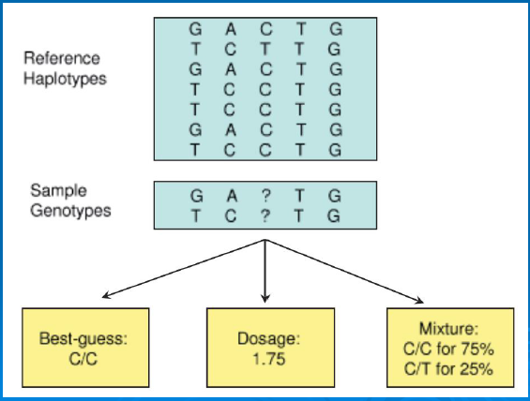
Choices of analysis methods

